Slide 1
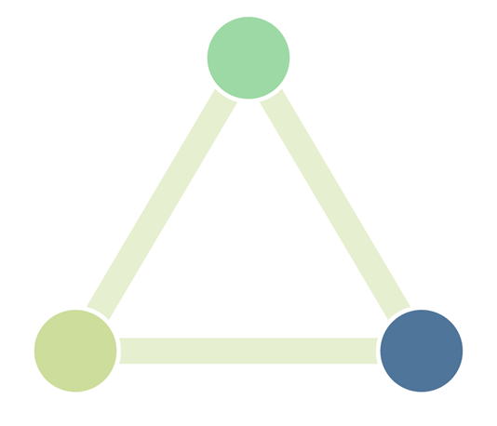
06.11.2024 - TRI1/6 Flexibility in industry event
Input from Resilient project:
Energy flexibility from industrial process heating - Relevance, system impacts and ways forward
Tobias Fleiter, Khaled Al Dabbas, Benjamin Lux, Wolfgang Männer
(Fraunhofer Institute for Systems and Innovation Research)

Slide 2
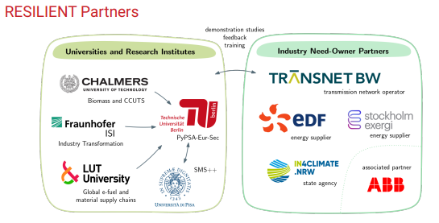
Partners in the Resilient project

Slide 3
Objectives of the study
Context:
The climate-neutral energy system will be characterised by strong sector coupling and the very high importance of fluctuating generation from wind and PV
This greatly increases the need for flexibility in the system
A climate-neutral industry will increasingly use electricity and hydrogen
Industrial companies are already participating in the electricity market (e.g. CHP) or operating plants flexibly (e.g. aluminium), but the quantities are still small
Approach
Use energy systems model with high hourly resolution for the entire European energy system
Use of perfect foresight linear cost optimisation model
(Partial) integration of industry sector into overall energy system model to endogenise investment and operation decisions
Case study for Germany

Slide 4
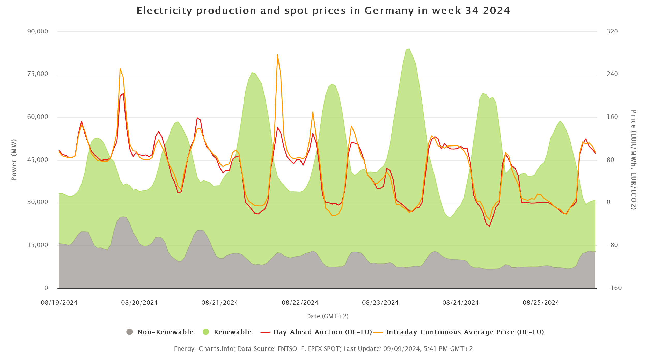
Motivation: First a look back
Source: Fraunhofer ISE Energy Charts
Price peaks in the morning and especially in the evening
Negative prices at lunchtime (on WE)

Slide 5
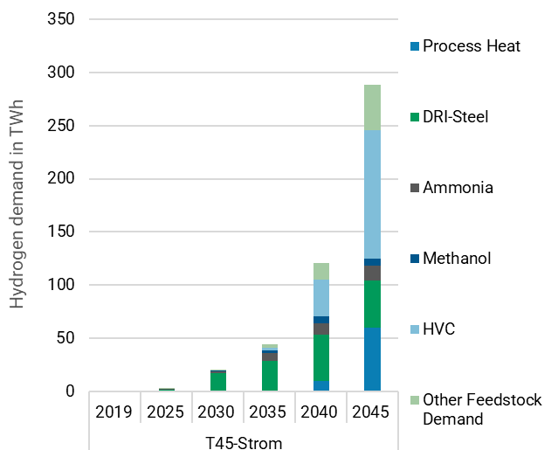
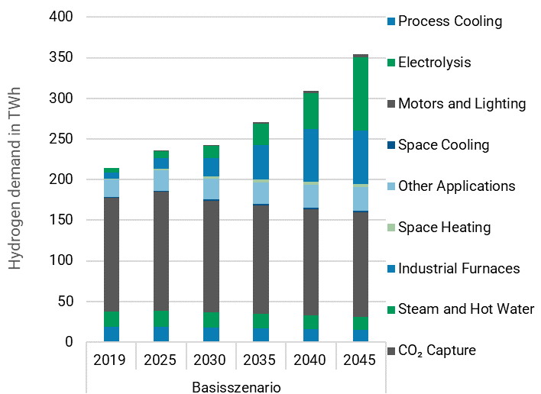
Strong increase in hydrogen and electricity demand from industry expected
Hydrogen and electricity demand in industry by application
Hydrogen
Electricity
+ 150 TWh
+ 290 TWh
Electricity and hydrogen will become the most important energy sources for industry

Slide 6
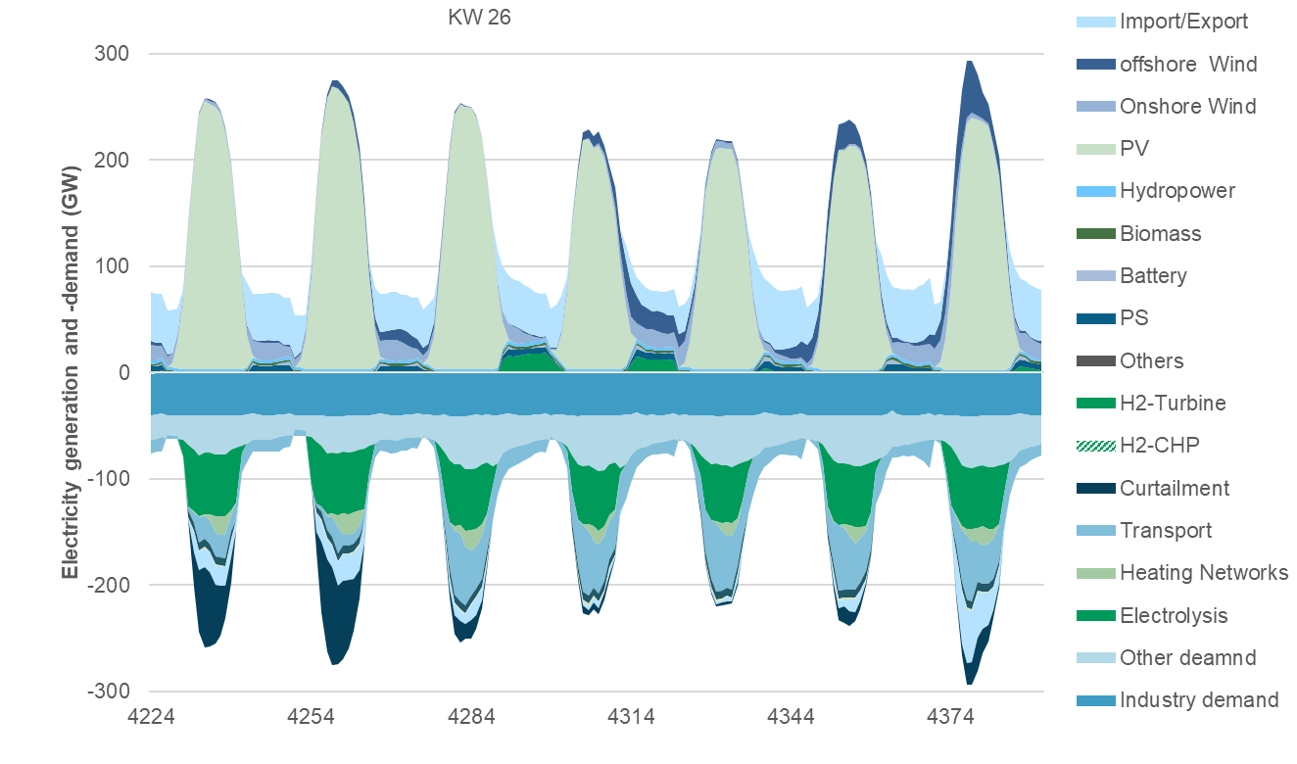
The electricity system needs seasonal balancing and short-term flexibility
Electricity generation and load - summer week (week 26) in 2045
Electricity system 2045 compared to today:
Electricity demand: +140% to 1200 TWh (about 510 TWh in 2023)
Inst. capacity from wind and PV +300% to 570 GW (150 in 2023)
Load + 300% to around 50-300 GW (today about 40-80)
Literature analysis Flex potential of already electrified processes:
~5 GW load reduction for 4h

Slide 7
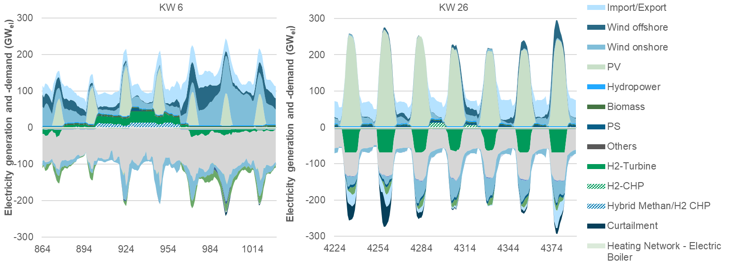
The electricity system requires seasonal balancing and short-term flexibility
Electricity dispatch 2045 in winter and summer in comparison
Winter week in the year 2045
Summer week in the year 2045

Slide 8
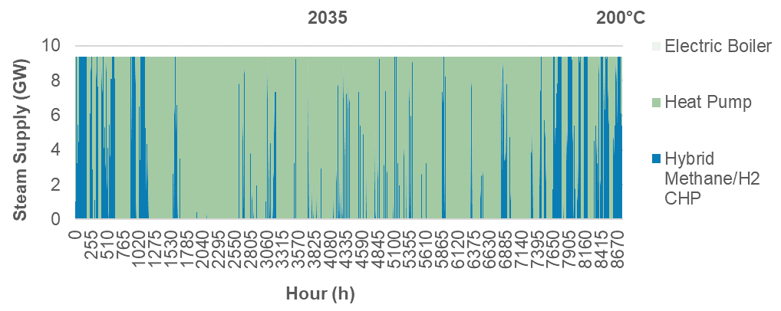
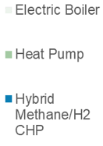
Process steam: operation of hybrid systems is clearly seasonal
Combined use of electric heating and CHP is cost-efficient
Electricity
Methane
Hydrogen
2045
The flexible hybrid supply of process heat with natural gas/H2 and electricity is cost-efficient from a system perspective.

Slide 9
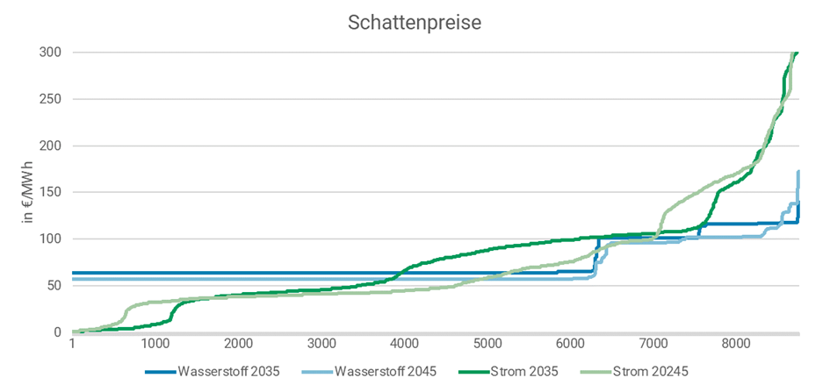
Framework conditions for economic evaluation
Price trends for gas, electricity and hydrogen
Price trends and price variability:
Energy price expectations in the model:
Electricity prices with greater variability compared to hydrogen
Hydrogen storage systems dampen price variability
Additional revenues in the balancing power market and congestion management possible
price developments in the energy market in the short term:
Gas cheaper than electricity
Hydrogen more expensive than electricity
long-term price trends in the energy market:
Gas prices rise with ETS prices
Hydrogen prices fall with low electrolyser and storage costs, rapid wind/PV expansion
Shadow prices
Gas prices (incl. ETS price)
2030: 55 Euro/MWh
2045: 75 Euro/MWh
H2 2035
H2 2045
Electricity 2045
Electricity 2045
Notes:
Balancing power market
Balancing power market as an indicator of flexibility
Wide range of marketing revenues
Largest revenues with PRL/SRL of 50,000 - 250,000 euros/MWh/year
Congestion management
So far only cost-based
New instruments under discussion at EU level (flexible grid connection commitments, new bidding zones)
Utilisation instead of curtailment (§13k EnWG)
when hydrogen storage is available at low cost

Slide 10
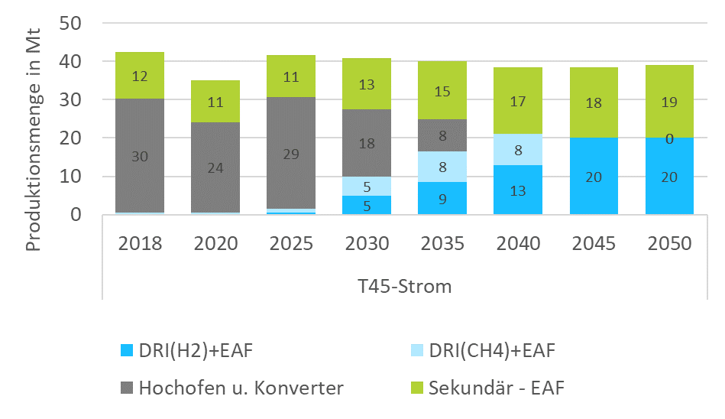
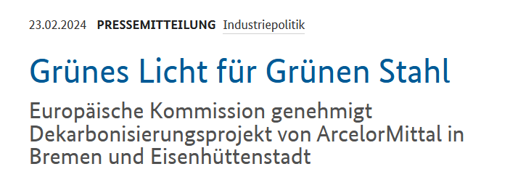
Overview of the Iron and Steel Scenario Assumptions for Germany
Recycling: Increase in secondary steel share from 30% (2018) to 50% (+8 Mt) by 2050
Process switch: Replacing 17 Mt blast furnace production by direct reduced iron (DRI) by 2035
Flexibility in DRI operation blending CH4 and H2.
Production (Mt)
Year
Primary- DRI-H2 +EAF
Primary- DRI-CH4 +EAF
Primary- BOF
secondary - EAF
Seite 10

Slide 11
Hybridisation of steel production creates seasonal flexibility
Use of H2 and natural gas in DRI production as an annual profile for 2035
Winter operation relying solely on natural gas
Flexible mixed operation in summer
CH4 demand Hybrid DRI
Demand Hybrid DRI (GW)
H2 demand Hybrid DRI
Hour (h)
A clearly seasonal profile of the use of H2 and natural gas in DRI systems is cost-efficient from a system perspective – during the transition phase.
Notes:
Results
A clearly seasonal profile of the use of H2 and natural gas in DRI systems is cost-efficient from a system perspective - in the transition years.
Hydrogen is not used in winter to minimise system costs.
The hydrogen storage requirement can thus be reduced by around 23 %.
Classification
High residual loads mainly occur in winter.
Hydrogen will become the central seasonal storage medium in the energy system and shift renewable electricity into the winter.
Overall, hybrid DRI plant management changes the annual use of energy supply technologies only slightly.
The flexible use of natural gas and hydrogen creates resilience to delays in the development of hydrogen infrastructures, especially hydrogen storage facilities.

Slide 12
Core results of the system analysis
1
The climate-neutral energy system will be strongly characterised by wind and PV as well as a high degree of sector coupling. There will be a high demand for hourly and seasonal flexibility.
2
In the coupled energy system, flexible loads follow the supply of renewable electricity. At the same time, the potential for industrial flexibilisation should be realistically assessed.
3
Hybrid systems as combinations of electric heating and CHP are cost-efficient and beneficial to the system.
4
Initially, heat pumps or electric boilers should supplement gas-fired CHP systems, which can be converted to hydrogen in the long term.
5
If possible, natural gas and hydrogen should be used in a flexible mix during the transition period. The operation of future direct reduction plants in steel production in particular has great potential.

Slide 13
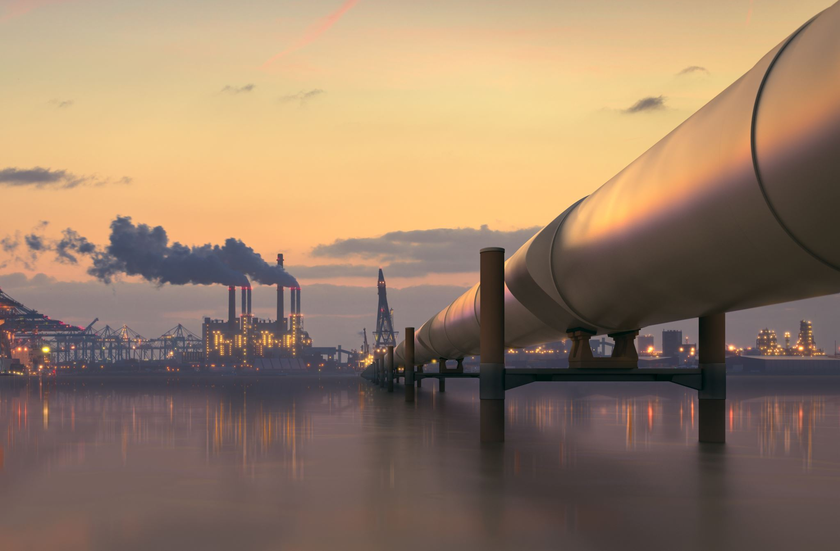
Outlook: Related work streams for the resilient project
Endogenisation of the industry sector in the energy system model Pypsa-EurSec
Endogenous invest decisions in new plants according to modernisation cycles for major energy-intensive industries
Operational flexibility e.g. by using hydrogen and natural gas in the transition period
Endogenous investment decisions for hybrid systems in steam generation
Realistic technology potentials, e.g. for high-temperature heat pumps

Slide 14
Thank you for your attention!
—
Contact:
Dr. Tobias Fleiter, Khaled Al-Sabbas M. Sc.
Tobias.fleiter@isi.fraunhofer.de Khaled-al-dabbas@isi.fraunhofer.de
Fraunhofer Institute for Systems and Innovation Research ISI
Breslauer Straße 48
76139 Karlsruhe
www.isi.fraunhofer.de

