Slide 1
Precision curing technology

Slide 2
Carbonaide provides a novel curing technology for
precast concrete.
Technology is developed at the
VTT Technical Research Centre of Finland and utilizes carbon dioxide as chemical curing agent.
Notes:
Carbonaide's award-winning carbon-curing technology, originating from VTT, the Technical Research Centre of Finland, can mineralise CO₂ during the concrete production process, reducing the footprint of concrete by 30% - 170%.

Slide 3
90%
of concrete CO₂ emissions originate from cement.
By 2050, volumes of concrete will double, while emissions must reach net zero.
Notes:
Concrete is responsible for 8% of global emissions. By 2050, volumes of concrete will double, while emissions must reach net zero. 90% of concrete CO₂ emissions originate from cement, which also accounts for half of the concrete production cost.

Slide 4
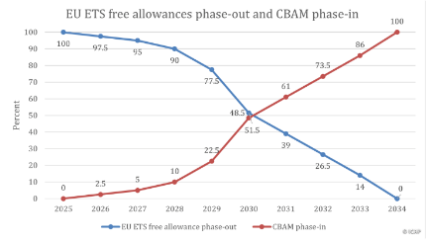
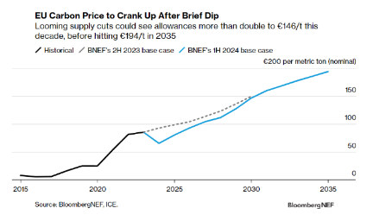
Challenges
Cement price increase is accelerating
Energy price increase
EU-ETS is going to affect on cement price
Blending ratio of the cements is increasing
Slower strength development and lower production volumes compared ordinary portland cement
Evident green transition of the society.
Legislation and consumer behaviour are enforcing the green transition also in construction sector.

Slide 5
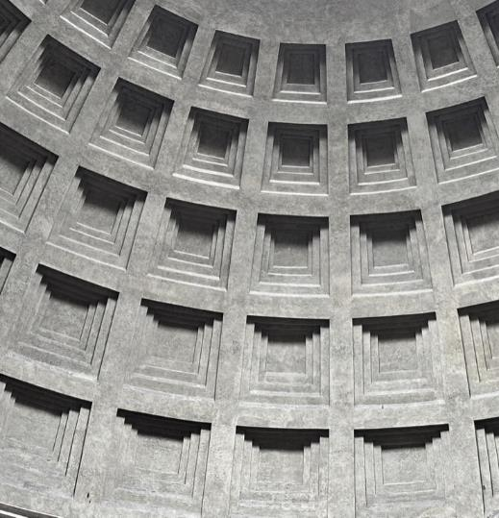
Combining utilization and permanent storage of CO₂
Carbon curing improves the mechanical properties of concrete and accelerates the strength development.
Reducing cement content by 20-50%.
Enabling high blending ratios for cement and new ultra low-carbon SCMs.
Reducing curing times and efflorescence.
Approximately 100kg of CO₂ mineralized per cubic meter of concrete.
Notes:
With minimal changes we can replace 20% of the cement with CO2, cutting emissions and costs.
Blending ratio of the cements is increasing, causing slower strength development and lower production volumes compared ordinary portland cement.
Carbonaide’s technology enables utilization of blended cements in a similar way as current cements.

Slide 6
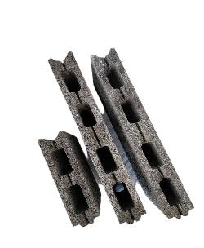
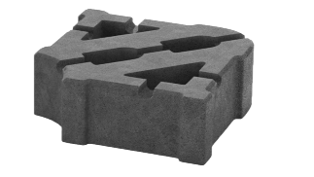
First commercial products
40% cement reductions. In total 57% lower footprint.
20,4% mineralized CO₂ from the weight of the cement.
CO₂ uptake was maximized. In total 48% lower footprint.
Significant strength increase with precision curing.
Notes:
Mechanical properties of new carbonated products and regular production were very similar.
Almost full compressive strength achieved only in 12 hours - half the time in comparison to traditional concrete manufacturing.
The density of the both products was 1100 kg/m3.

Slide 7
Carbonaide’s technology
Carbonation process modules
CO₂ tank
Curing chambers

Slide 8
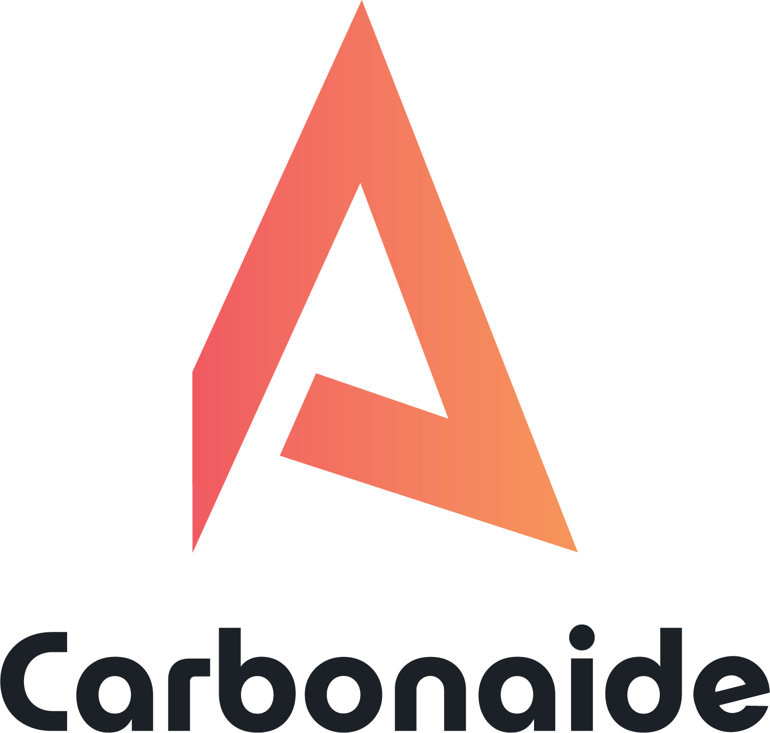
Fostering collaboration
$
$ / tCO₂
Precast factory
Voluntary carbon markets
1000-5000 tCO₂/a
CDR credits
Buyer of concrete
products
$ / tCO₂
CO₂
$ / tCO₂
CO₂
Biogenic CO₂
Fossil CO₂
(EU ETS in 2026)

Slide 9
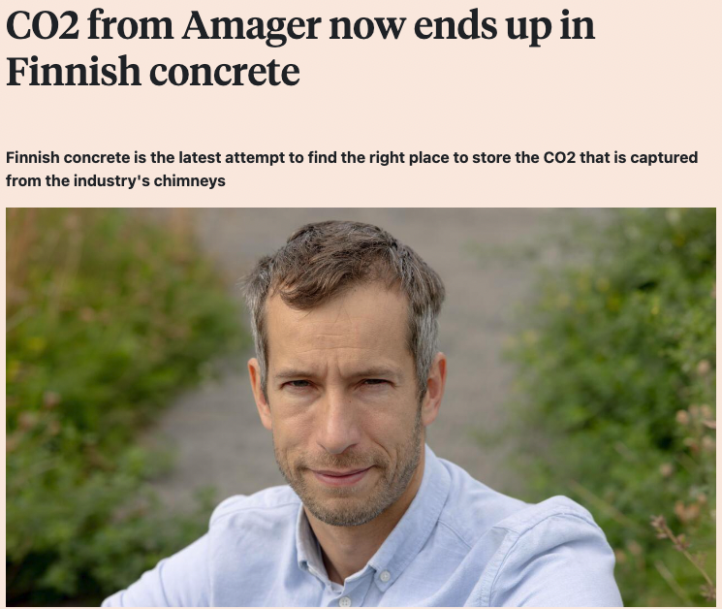
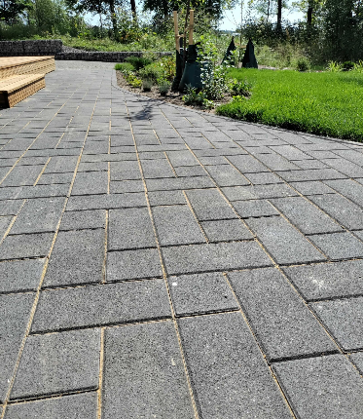
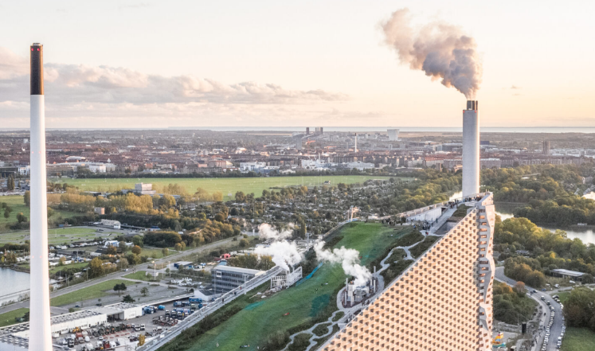
Børsen 1.10.2024: ARC Amager Bakke power plant in Copenhagen
Notes:
The technology is an add-on to existing value chains and it can be easily integrated into existing factories. It can mineralize and permanently store 100kg CO₂ per m³, in atmospheric pressure.

Slide 10
Improved utilization rate for CCU & CCS carbon capture installations.
Commercially ready for concrete actions.
Notes:
The technology is an add-on to existing value chains and it can be easily integrated into existing factories. It can mineralize and permanently store 100kg CO₂ per m³, in atmospheric pressure.

Slide 11
Contact us
Jonne Hirvonen
COO and co-founder
jonne.hirvonen@carbonaide.com
+358 40 632 4999
www.carbonaide.com

